Slide 1
International Graduate Workshop
Office of International Services
Thursday, November 21st, 2024

Slide 2
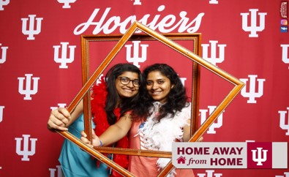
Welcome!

Slide 3
Agenda
Introduction
Admissions Updates
Sponsored Students
Orientation Updates
Immigration & Insurance
Refugee Taskforce

Slide 4
IU Global Introduction John Wilkerson, Associate Vice President of International Services

Slide 5
Admissions Updates Renee Lacy, Senior Credentials Analyst Chris Adams, Senior Associate Director of International Admissions

Slide 6
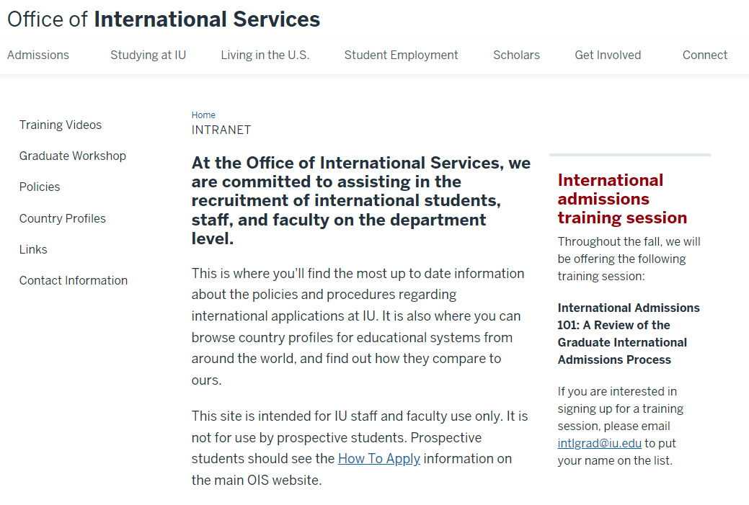
The Helpful OIS Tool: The INTRANET
https://ois.iu.edu/intranet/index.html
What does it include?
Training Videos
Policies
Country Profiles
Links
If you need access to the Intranet, please reach out to Intlgrad for the login information.

Slide 7
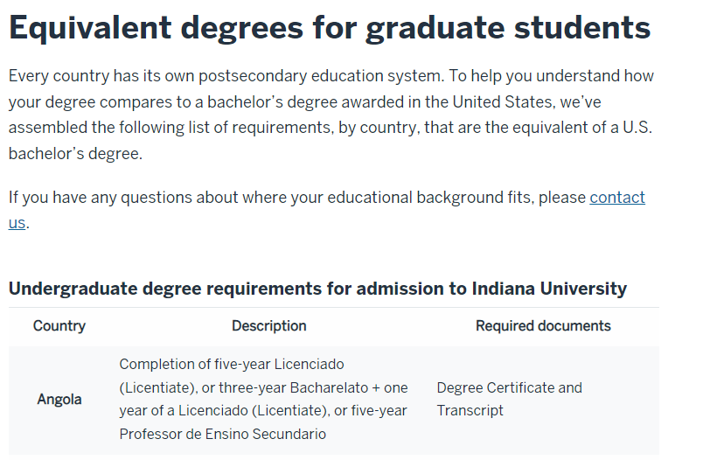
What We Need for a Bachelor’s Equivalency Determination
In general, the OIS wants to see a 4-year bachelor’s degree from a recognized institution.
If the bachelor’s degree is less than 4 years, we would want to see additional year of study at a higher level until 4 years have been met.
For example, a 3-year bachelor’s degree followed by at least 1 year of coursework in a master’s degree, or a postgraduate diploma program, would potentially be considered bachelor equivalent.
For more general information on what we expect to see from specific countries, please visit the OIS website.
If a student has completed coursework at another institution, and that coursework is listed as transfer credit on the final bachelor's transcripts, our policy is to request final, official transcripts from all institutions.

Slide 8
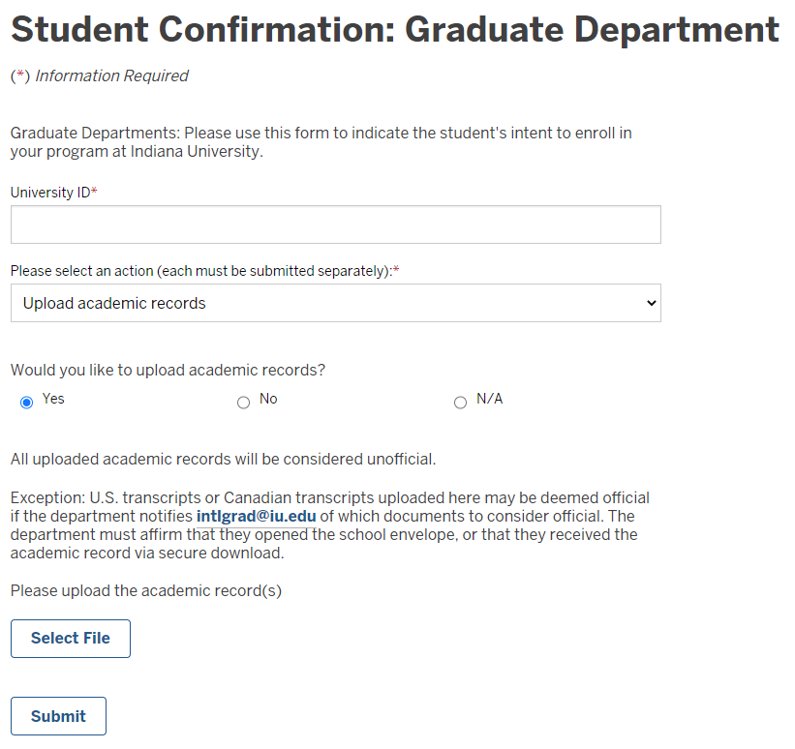
Student Confirmation E-form: Upload Academic Records
Anything uploaded via this e-form is always considered unofficial. Uploading a record is the same as sending us a photocopy. We can use it for the review, but we cannot consider it official.
EXCEPTION: If the department received an official record from a USA or Canadian school and uploads it in Altas, you can email Intlgrad after the upload and confirm your office evaluated it as official. We will honor that and deem it official as well but only if we receive the confirmation from the department in Intlgrad.
Any other international record will always be unofficial – to be deemed official, it must be sent directly to our office for evaluation.
*If your department receives physical records for a student, and you would like for the OIS to complete a review, please forward the unopened documents to the OIS via Accountable Mail.

Slide 9
Issues Obtaining Official Academic Records
As we mentioned last year, our office is moving back to requiring records sent through mail or official digital delivery services.
On a case-by-case basis, as a last resort, we can look into accepting PDF attachments of academic records directly from the school as official:
The school must state they are unable to produce physical records
The school must be unable to use a secure method of sending digital records
The records MUST come from the registrar's (or equivalent's) office
We MUST be able to verify the sending email address on the school website
The records MUST be sent directly to newtoiu@iu.edu and not forwarded from someone else

Slide 10
A11 Extensions
What is an A11?
The hold that the OIS places on the student’s record if they still need to provide final/official academic records used for admissions purposes.
We are approving all A11 extension requests so long as the student will not be entering their final semester of studies at IU. If a student is entering their final semester, they will be required to meet with a director.
Important!!! Students CANNOT GRADUATE FROM IU until all final/official records used for admission are submitted and recorded in the Ed Panels in SIS.
It's tempting, but don't be deceived by seemingly endless extensions. When an extension is granted, the department should ensure that the student understands that we still require all admission records.

Slide 11
Program/Plan Changes & Deferrals
When your students require a program/plan change or deferral, please follow the steps below:
Change the original apps local status to ‘Program/Term Change’
Add the designation for the desired program, plan, or term
Change the original apps local status to ‘Applicant Withdrawn’
Once these steps have been followed, a new application will be generated in SIS and Atlas.
We request that the department alert us to any adjustments so that we can monitor and ensure that the changes took effect.
*For students that wish to defer their application, we ask that each department work with their students to ensure that they drop all their enrolled courses prior to the deferral request being submitted.

Slide 12
GRAD Applicants with International Coursework
Applicants that are coded as GRAD in SIS, but have international coursework, will not automatically be reviewed the OIS. To complete an evaluation, the department must:
E-mail Intlgrad to Request an Atlas Profile (if one is not already available in Atlas)
Submit the “Graduate Department Request for Evaluation” in Atlas
NOTE: Please be sure to include/check mark all of the information that you are requesting with the evaluation

Slide 13
GRAD Students with International Coursework
If a GRAD student has international coursework, the update of their Education Panels does not automatically fall of the OIS. Due to their GRAD coding, the Education Panel updates are technically the responsibility of the graduate department and the University Graduate School. If a graduate department would like the Education Panels updated for a GRAD student, they must:
Reach out to Intlgrad via e-mail to let us know that the department would like the Ed Panels updated
Instruct the student to submit their academic records to the OIS, either via physical mail or front desk drop off

Slide 14
Discussion Topics
The Office of International Services does not set English Proficiency standards for graduate applicants/students. It is up to each individual department to set their own standards; the OIS just asks that these standards be applied equitably across their student population. Additionally, we ask that EP standards be published and readily available on the department's website.
The Office of International Services can review off unofficial academic records for the bachelor’s equivalency review and for the admission of international students. If other departments/university offices require official documentation for admission, how is this information relayed to the student?

Slide 15
Thanks for your patience with us!
As we’re in our busy season, response times may be delayed. We will continue to prioritize by term and date received as we work through the workflow/mailbox.
Intlgrad@iu.edu is here for you as a resource; let us know if you have any questions/need assistance!

Slide 16
Please ensure that you've updated your internal and public-facing information to reflect our new location:
Ferguson International Center 330 N. Eagleson Ave Room 100 Bloomington, IN 47405
Ferguson International Center
330 N. Eagleson Ave
Room 100
Bloomington, IN 47405

Slide 17
New Stamping Procedures for Academic Records
No more physical stamping
Digital stamping only
Atlas digital doc access terminates 10 weeks from the start of EACH academic term.
Some digital stamp examples:

Slide 18
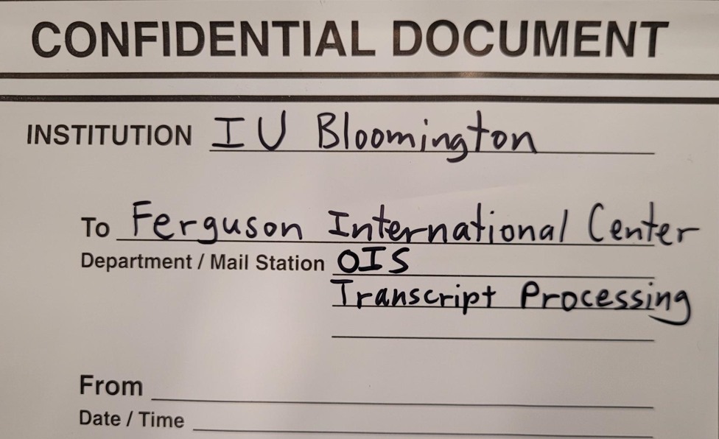
Accountable Mail
Academic records received from departments via accountable mail will be returned to departments via accountable mail.
Non-irreplaceable academic records received from students or other institutions will be sent to departments via accountable mail.
Documents will be sent at the earliest opportunity.
Email intlgrad@iu.edu if your address or contact information needs updated to receive Accountable Mail
Best way to send our way!

Slide 19
Sponsored Students Daniel Whitmer, Senior Associate Director, Sponsored Student Services

Slide 20
Sponsored Student Programs – Bringing the World to IU
Australia (1)
Azerbaijan (1)
Botswana (1)
Brazil (1)
Chile (1)
Dominican Republic (1)
Guyana (1)
Hungary (2)
India (1)
Tibet (3)
Indonesia (22)
Ireland (1)
Japan (1)
Kazakhstan (3)
Kenya (1)
Kosovo (1)
Kuwait (9)
Kyrgyzstan (1)
Malawi (1)
Malaysia (1)
Mongolia (3)
Morocco (2)
Nigeria (1)
Oman (8)
Pakistan (5)
Panama (1)
Paraguay (1)
Russia (1)
Saudi Arabia (86)
Sierra Leone (1)
South Africa (1)
South Korea (6)
Switzerland (1)
Taiwan (10)
Thailand (1)
Trinidad and Tobago (1)
Turkey (6)
United Arab Emirates (27)
United Kingdom (1) Uruguay (1)
Vietnam (1)
Notes:
219 total Sponsored Students from 41 countries.
129 sponsored GRAD students
49 Fulbright program (degree and non-degree)

Slide 21
Grad Sponsored Students by School
Business (9)
College (16)
Education (22)
Law (14)
Media (2)
Music (4)
Public Health (7)
SGIS (17)
SICE (12)
SOAAD (1)
SPEA (25)

Slide 22
Sponsored Students
Definitions
Funding
Foreign Governments
Home country employer/university
Fulbright
Recruitment and Admissions Issues
Contact: Daniel Whitmer, Senior Associate Director, Sponsored Student Services, djwhitme@iu.edu
Exchange graduate students:
Megan Straughn***, Coordinator for Special Programs intlexch@iu.edu
Notes:
I am the only person in OIS that recruits for all IUB programs at all levels. At the graduate level, the countries that I am at most frequently as of late are Indonesia, Thailand, and Gulf countries in the Middle East. For some of our master's programs I have fairly decent knowledge of the program and application requirements. For all of your programs, I am relying heavily on your department website to help potential applicants learn how to find program details so that they can determine best fit, concentrations, application requirements, etc. For potential doctoral applicants, I'm typically providing a higher level review of the typical application requirements and doing some coaching or cheerleading - think GRE!. Speaking of GRE, that is still the greatest obstacle for many applicants around the world (not only in terms of the test itself but getting access to a testing center and paying).
Sponsored Students: typically fully funded by a home country government, employer, or other outside organization, such as Fulbright.
Funding: foreign governments:
Majority provide full funding
A few are looking for cost-share and will prioritize student placement according to award package.
Fulbright admits: many of you are the most familiar with me through Fulbright apps. The US State Department does expect universities to do cost-share with this program. So it is important that for any admitted Fulbright applicant that we are able to offer a reduction to the in-state rate for tuition, at minimum.
Most Fulbright applications come through me, and I am forwarding the dossier which includes academic records, personal statement, test scores, recommendation letters, to your department. However, there is a small group of "self-applying" Fulbrighters. If you have received an e-app from an individual that has mentioned they have received a Fulbright award, it would be helpful to know about it so I can reach out for confirmation.

Slide 23
Orientation Updates LeeAnn Jones, Assistant Director, International Student Life Iesha Sturgis-Jackson, Assistant Director, International Student Life
Notes:
LeeAnn

Slide 24
International Orientation
Here is what we can cover:
Atlas Checklist
Canvas Online Orientation
Immigration Review
Submitting Academic Records
TB Testing/ Immunization Compliance
Optional Social Events
Notes:
LeeAnn

Slide 25
Canvas Online Orientation
Notes:
Iesha

Slide 26
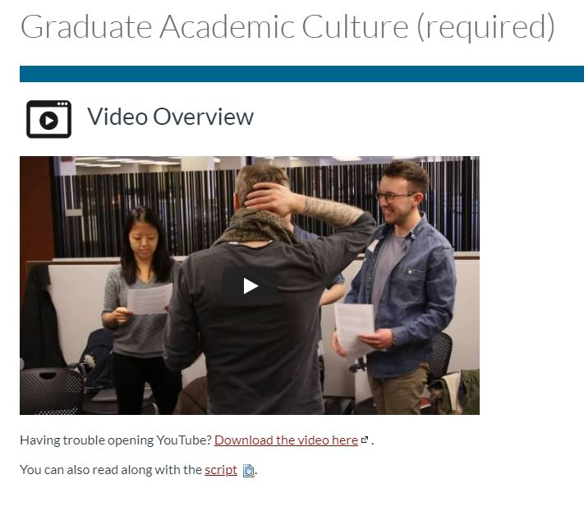
Video Tutorials & Quiz
Notes:
Iesha

Slide 27
Online Guidebook
Notes:
https://iu.instructure.com/courses/2244861 (Iesha)

Slide 28
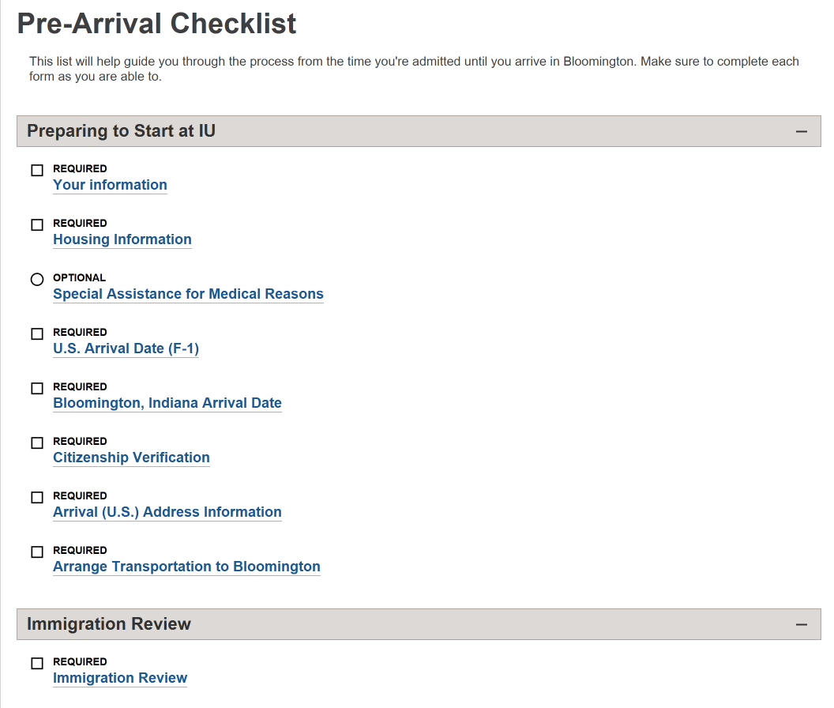
Atlas Checklist
Notes:
LeeAnn

Slide 29
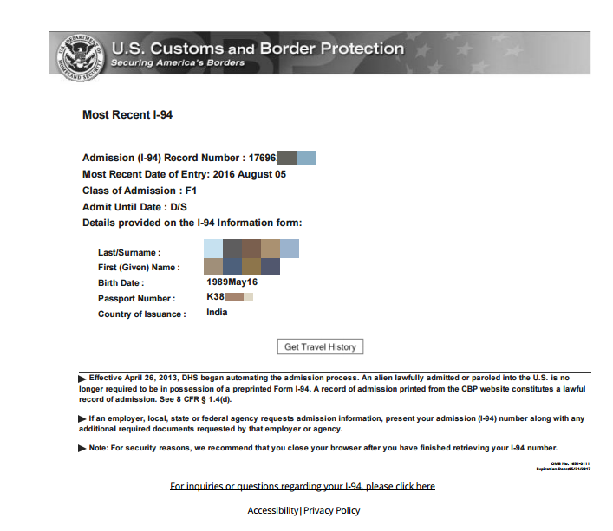
Submit Immigration Documents
Gather your immigration documents.
Passport information
Visa stamp
I-20 or DS-2019
Latest I-94 Download as soon as possible at https://i94.cbp.dhs.gov/home
Notes:
LeeAnn

Slide 30
Immigration Review
Students upload documents *after* US arrival via Atlas. International Student Advisors review documents online after student completes upload (allow 2 business days).
Required to be completed before registration hold can be removed.
Essential: Students complete Immigration Review ASAP upon US arrival.
Notes:
LeeAnn

Slide 31
Submit Final Academic Records
Determine What Needs to be Submitted
Students can find this in the Next Steps page of their admission letter. Records must be official, original, have an English translation if not originally in English
Gather Documents
Students will need to contact their school to gather all the required original materials for submission.
Submit Originals to OIS
Submit documents to OIS in the Ferguson International Center (330 N Eagleson Ave).
OIS Reviews Documents
It takes up to two weeks for OIS to review submitted document
Hold is Removed
The hold will be removed once OIS has finished reviewing the documents. Students can check student center in One.IU
Notes:
LeeAnn

Slide 32
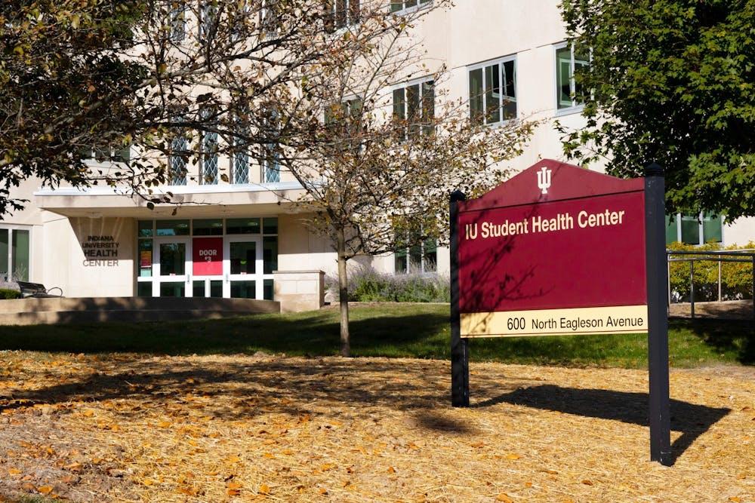
TB Testing and Immunization Compliance
TB Testing is mandatory law
Must be done in United States
Students can make an appointment at the Health Center
Encourage new students to make an appointment as soon as possible
Notes:
LeeAnn

Slide 33
Examples of Arrival Social Events
Grad-Scholar Welcome Reception
Ice Cream Social
Hoosier Fest (Phones and Banks Resource Fair)
Board Game Night
Bowling and Billiards with Late Nite
Notes:
Iesha

Slide 34
Programs After Orientation Grad-Scholar Connect
Grad-Scholar Connect (GSC) gives graduate students, scholars, and their families a place to gather each month.
Outdoor Yoga
Vision Board Party
International Trivia Night
Mocktail Mixology Class
Karaoke Night
Indoor Bouldering
Notes:
Iesha

Slide 35
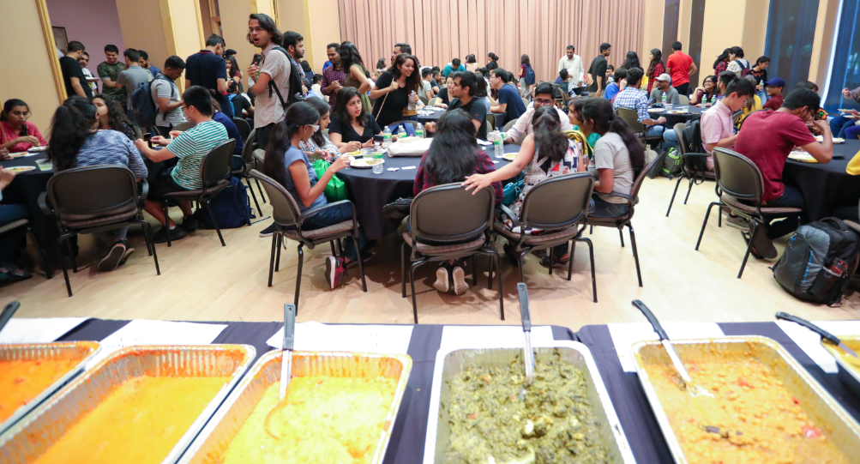
Tentative Fall 2025 Schedule
I-20 Required Arrival Date: Will follow a similar pattern as in previous years
Can arrive to the US as early as 30 days before their required arrival date
Classes begin Monday, August 25
TB testing- please contact the Health Center to schedule block testing to fit with your departmental orientation
Optional social programming
Notes:
Iesha

Slide 36
Immigration & Insurance Updates Jenny Bowen, Director, International Student Advising Christina Fidel, Director of Client Services

Slide 37
Admit letters
SAA or similar funding
Students limited to 20 hours/week of on-campus work
"expected to work at least 20 hours/week" is problematic
On-campus = IUB only (other campuses need authorization)
If the type of SAA is known, stating that in the letter is helpful
If offering hourly work (vs an SAA), only hours that are guaranteed will be able to be used for I-20 creation
Program starting in the summer?
2nd 8 weeks admission and enrollment required
In-person (total of 4 cr hrs, and at least one class must be in-person)
Enrollment needs to cover the entire 2nd 8 weeks (early June – end July)

Slide 38
Full Funding (SAA, Fellowship, etc.)
Did you offer funding?
Please fill out the "Student Confirmation: Graduate Department" e-form to let us know if the student accepted it
Full funding (student shows no additional financial documentation, unless bringing dependents):
full tuition remission/fees
stipend
health insurance

Slide 39
Admissions-adjacent
Current students changing programs within the department/moving from one department to another, need a new immigration document. (OIS can provide some sample language for admission letters, if that's helpful!)
If your student will need J-1 status, we will need an official English proficiency score
Students admitted for spring 2025 will be asked to arrive on January 8, 2025 (classes start on Jan 13)
Demonstrating non-immigrant intent - NAFSA's 10 Points to Remember When Applying for a Student Visa
OIS outreach about program changes (summer!)

Slide 40
A few other details
A19 holds – take effect in the second week of classes
New students (including students who have taken a break and are returning)
Need to do Pre-Arrival Checklist (through Immigration Review!) upon arrival to U.S. (A19); hard CAS interrupt starts on 1/20/2025
Late arrival? Consider dropping classes on or before January 9.
Enrollment requirements
Online enrollment is limited – only 3 credit hours of online classes can count towards full-time enrollment.
In-person classes are coded as P [In Person (0-25% online education)] or HY [Hybrid-On Campus and Online (25-75% online education, remainder is face to face)], and in some cases, IS or IN.
13 week classes can be tricky, unless student is also enrolled in full semester classes
Remember that 30 weeks of in-person enrollment are needed for a student to be eligible for CPT/OPT.

Slide 41
A few other details, continued
Reminders about continuing students
On-campus work authorization – 20 hours/week until 12/20; winter break (12/21/2024 - 1/12/2025), then 20 hours/week from 1/13/2025 (IUB only!)
Completing in the 13 week term in fall 2024? Stop working 11/22/2024.
Internships required?
Reminder: International students need authorization to partake in internships, practica, experiential learning, etc.
Eligible only after student has been in the U.S., enrolled full-time, for 30 weeks
Dismissals (sorry for the downer!)
Please reach out to OIS if you're working with a student who may be dismissed, so that we can assist with immigration-related timing concerns.

Slide 42
Resources
Immigration 101 Series:
International Student Immigration Basics for Academic Advisors and Graduate Departments
Enrollment, Extension, & Program Completion
F-1 Student Employment & Practical Training
Curricular Practical Training
Optional Practical Training
On-Campus Employment
Enrollment Requirements

Slide 43
Applying for a Social Security Number
All F-1 and J-1 students working on campus need an SSN
All students should wait at least 2 weeks after arriving in the US to apply for their SSN (info won’t be immediately in the SAVE database)
Most F-1 students will need a DSO letter from OIS (requested in Atlas) – exceptions are F-1 students who are on CPT or have an Employment Authorization Document.
All J-1 students sponsored by IU need a sponsor letter to obtain an SSN (can be requested in Atlas). J-1 students not sponsored by IU should contact their program sponsor to get a letter.

Slide 44
Requirements
International students and their dependents are required to be enrolled in the IU International Plan while they study in the U.S.
The premium (Health Insurance Fee) can be billed to a student's bursar account 30 days before the 1st day of classes if the student is already registered in IU classes.
Fall 2024 (Aug. 1—Dec.31): $772.55
Spring 2025 (Jan. 1—July 31): $1070.45
Dependents must be enrolled separately.
Students do not choose to enroll in the plan. Enrollment happens automatically unless the student has an IU assistantship or fellowship.

Slide 45
But what if students don't want our insurance?
Students can be exempt from paying the Health Insurance Fee IF they meet very limited exemption requirements and submit a Health Insurance Exemption Request in Atlas.
Deadline: 10th day of classes
Acceptable exemption categories are available on our website: https://ois.iu.edu/living-in-the-us/health/insurance/student-insurance/exemptions.html
Students qualify for an automatic exemption if they have an IU assistantship or fellowship with other IU health insurance. More on this in the next slides.

Slide 46
Does your department have students with SAAs?
Covered under the SAA Plan from date of hire and automatically exempt from the health insurance fee in the beginning of the semester
Hire as early as possible – 8/1 for Fall, 1/1 for Spring
Hiring in the middle of a semester is problematic for health insurance purposes.
If hiring information is not in HRMS by the beginning of the semester, students will be billed for the IU International Plan. OIS audits charges and reverses them, but it takes time.
Students cannot be enrolled in both the IU International Plan and the SAA Plan. They must choose one.
New this year: regardless of when the SAA contract ends, insurance remains until 12/31 for Fall, 7/31 for Spring/Summer
No SSN? No enrollment in the plan. (!!!)

Slide 47
Students with a Fellowship of at least $6,750 per semester are covered under the IU Fellowship Recipients Plan and are automatically exempt.
Fellowship awards should be disbursed before HR sends their final list of eligible enrollees to Anthem – September or February
If disbursal has not happened by the beginning of the semester, students will be billed for the IU International Plan. OIS audits charges and reverses them, but it takes time.
If fellowship award is lost, insurance coverage remains.
No SSN required, no issue with enrollment
It's possible to waive the SAA or Fellowship Plan to join the IU International Plan!
Students with dependents could save money by switching to the IU International Plan.
Contact OIS to be enrolled and billed
File SAA/Fellowship waiver with University Health Plans.

Slide 48
Refugee Task Force Rendy Schrader, Senior Director of International Student and Scholar Programs and Initiatives Chris Adams, Senior Associate Director of International Admissions

Slide 49
Refugees and Education
Forcibly displaced people worldwide: 108.4 million
62.5 million internally displaced
35.3 million refugees
5.4 million asylum-seekers
5.2 million in need of int’l protection
https://www.unhcr.org/refugee-statistics/
In 2024, 7% have access to higher education, up from just 1% in 2019! UNHCR’s goal is 15% by 2030.
https://www.unhcr.org/us/news/briefing-notes/unhcr-reports-progress-refugee-education-tertiary-enrolment-rate-hits-7-cent#:~:text=GENEVA%20%E2%80%93%20Global%20enrolment%20of%20refugees,UNHCR%2C%20the%20UN%20Refugee%20Agency.

Slide 50
IU Refugee Support: Population by the numbers
42 students on refugee visas, 110 on asylee system-wide
At Bloomington: 27 undergraduates, 13 graduates
4 graduated in Spring 24
Collective GPA 3.63
Anticipating a class of 24 this Fall
Notes:
System-wide, the biggest displaced student populations are in Bloomington and Indy.
40 in Bloomington
67 in Indy
Many UG’s are either 2nd generation from Indiana’s last waive of refugees, or “transfers”, meaning their education has been interrupted.

Slide 51
Creative Financing – External Sources
Private Funding
Individuals
Churches
Established ethnic communities
Corporate Support
Agencies
IIE
President’s Alliance (for ideas)
ECAR
Resettlement Groups
Government
Federal – Pell grants
State

Slide 52
Creative Financing – Internal Sources
Provost
University Foundation
Housing
Talk to Financial Aid
Student-driven contributions
Admissions
First Generation programs
In-kind Support
Graduate Departments!

Slide 53
Thank you for joining! Questions/Comments?
Notes:
One of the main themes Rachel and I heard from our Global Gateway colleagues was that they are more than happy to connect with you all about recruitment ideas.
This might mean you have a dynamic professor in mind who you'd like to offer an Explore IU Workshop
This could be a question about university collaboration in a region
Whatever the idea is, they'd would love to engage
https://global.iu.edu/presence/gateways/index.html

